Slide 1
AIAA 5047 Responsible AI 2025 Fall
Sihong Xie, AI Thrust, Information Hub
Lecture 3
W2 201, 9-11:50 AM F

Slide 2
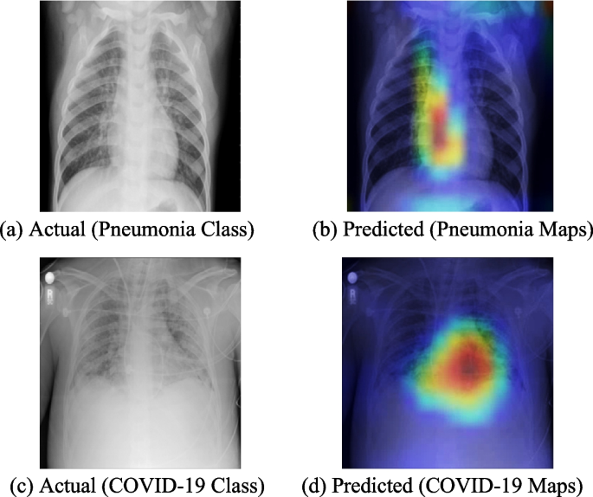
Motivations
To understand a model’s behavior
how and why a model arrives at a particular conclusion?
Example
A deep model trained to classify chest X-ray images into (a) Pneumonia or (b) COVID-19.
Do the model look at the right places to classify the images? “Right places” means those places where the doctors use for classification.
“Explanations” are defined as “regions of the images that are important to the model’s decision”.
By seeing the explanations, doctors can decide if the models are reliable.
Image Source:
Adaptive Mish activation and ranger optimizer-based SEA-ResNet50 model with explainable AI for multiclass classification of COVID-19 chest X-ray images. Chakravarthy, etc. 2024.

Slide 3

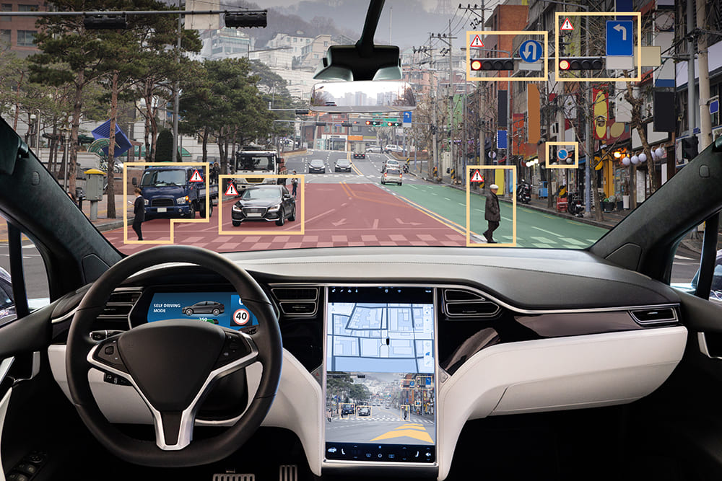
Motivations
To predict the model’s behaviors
Will the model behave well in novel or unexpected situations?
Example
In autonomous driving (a safety-critical AI application), it is important to predict the car’s behavior under unusual driving conditions.
It is possible that autopilot has not been trained on any conditions like this, and it did not recognize the all-white truck as an obstacle.
Interpreting what autopilot would recognize an overturned truck can be helpful.
In a Tesla accident, a Tesla with autopilot crashed into an overturned truck (edge case).
Autopilot:
Vision-only
Data-driven
Training data collected under usual situations cannot cover rare but dangerous conditions.
Image Source:
[1] https://insideevs.com/news/426312/video-tesla-crash-stopped-truck/
[2] https://www.mccormick.northwestern.edu/robotics/inside-our-program/stories/2023/making-autonomous-transportation-a-reality.html

Slide 4
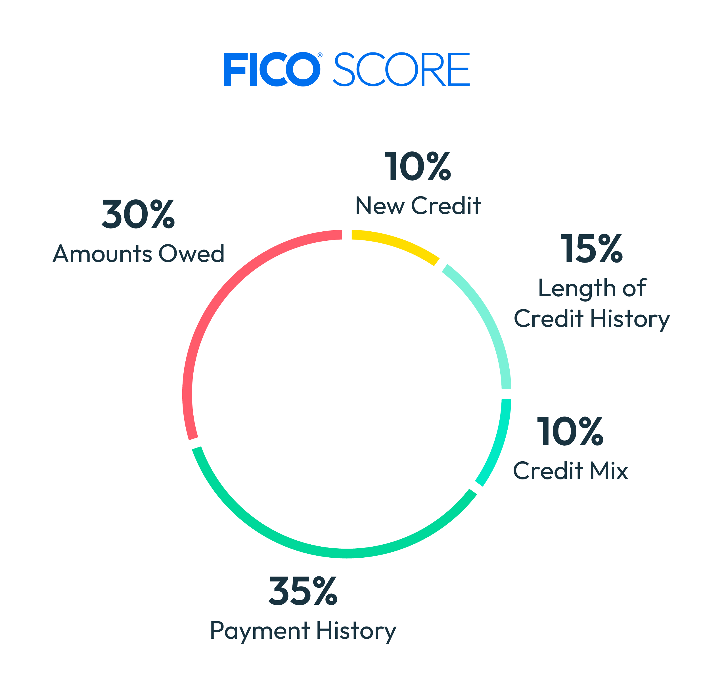



Motivations
To intervene: when an AI model makes a decision that impacts a person's life, it's essential to override that decision.
A clear explanation of why the decision was made helps with the intervention.
A credit card application
Global evaluation factors
Apply again
Interventions:
Reduce electricity bill
Less dining out
No purchase of luxuries.
……
Explanation: the case is denied because you owe too much, and reducing that by 50% will be helpful.
Image Source:
[1] https://www.dreamstime.com/stock-photography-hand-signing-fictitious-credit-card-application-image16568402
[2] https://www.myfico.com/credit-education/whats-in-your-credit-score
[3] https://creditmergency.com/why-was-my-credit-card-application-denied/

Slide 5


Motivations
friends
John
Explainable financial fraud intervention
Detecting suspicious financial accounts is not enough, but require human intervention to stop financial loss^{[3]}.
But a mis-classification, in particular, false positives (e.g., Kevin in the example on the right) can make innocent customers unhappy.
Explanations that justify why an account is suspicious can be useful for human to make more precise decisions.
same IP
same IP
Kevin
Detected by a
graphical model^{[1,2]}
True
Positive
False
Positive
John
Kevin
Explanation John is suspicious since 1) share IP with another suspicious account; 2) is a friend of another suspicious account.
Explanation Kevin is suspicious since 1) share IP with another suspicious account.
Publications from my group
[1] Review graph based online store review spammer detection. ICDM 2011.
[2] Inconsistent Matters: A Knowledge-guided Dual-consistency Network for Multi-modal Rumor Detection. TKDE 2023.
[3] Enhancing Robustness of Graph Neural Networks on Social Media with Explainable Inverse Reinforcement Learning. NeurIPS 2024.
This is an example inspired by a project we work with Tencent.

Slide 6
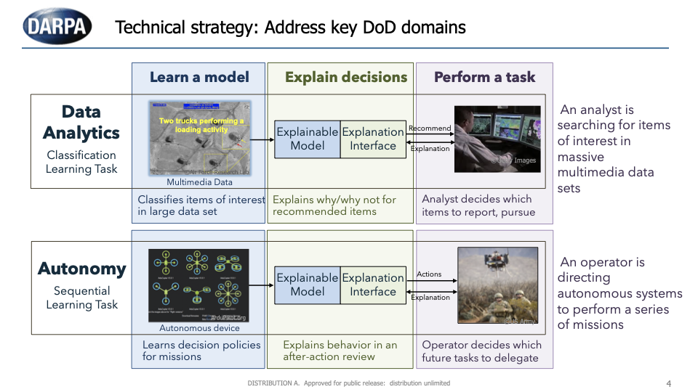
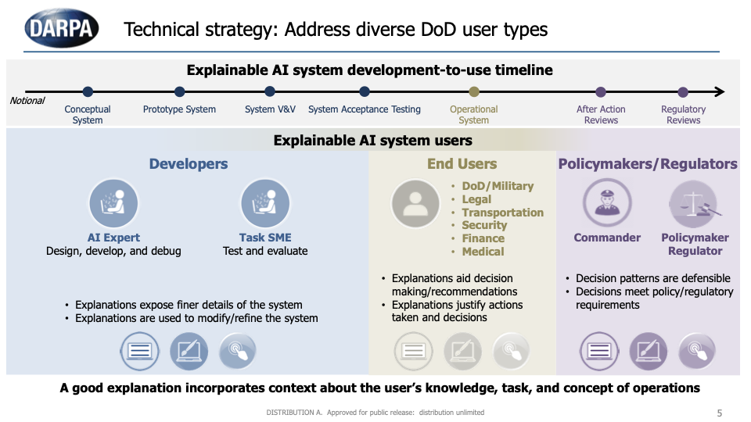
Motivations
AI for military missions
The AI provides suggestions and humans decide if take actions.
Examples
Satellite images analysis: AI found two trucks loading something, which can be suspicious targets. Cannot check onsite and decisions need to be made using AI explanations.
UAV needs to bomb a target, and the AI generates a policy that executes the task. How to ensure the policy is safe and also effective? Explanation help the operator review the rationale of the policy and improve it later.
Image Source:
DARPA 's explainable AI ( XAI ) program: A retrospective. David Gunning, etc. 2021.

Slide 7
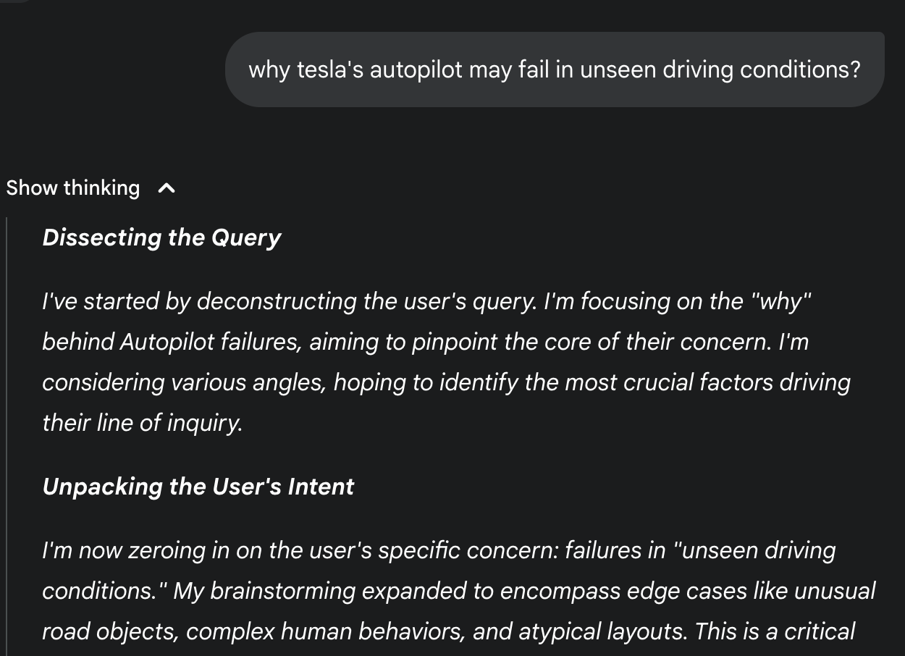

Motivations
CoT shows that Gemini understands keywords like “driving conditions”.
LLM explanations are critical:
Blackbox nature of most LLM.
Pretrained LLM has outdated knowledge^{[1]}
LLM can hallucinate^{[2]}.
Example
Retrieval Augmentation Generation (RAG) makes the information sources of LLM explicit, tracable, and verifiable (a sort of intervention).
Chain-of-Thought (CoT) guide LLM to reason in an explicit way, and can reduce hallucination (a sort of intervention).
DeepResearch techniques (e.g., Gemini) adopt both CoT and RAG to make the results explainable and improve user trust.
RAG and CoT are not entirely reliable, and there are other techniques (mechanistic interpretability, knowledge circuit) for explainable LLM.
RAG shows that Gemini relies on external sources (some are more reliable) to find the answer
Publications from my group
[1] MBA-RAG: a Bandit Approach for Adaptive Retrieval-Augmented Generation through Question Complexity. AAAI 2025.
[2] CogniBench: A Legal-inspired Framework and Dataset for Assessing Cognitive Faithfulness of Large Language Models. ACL 2025.

Slide 8
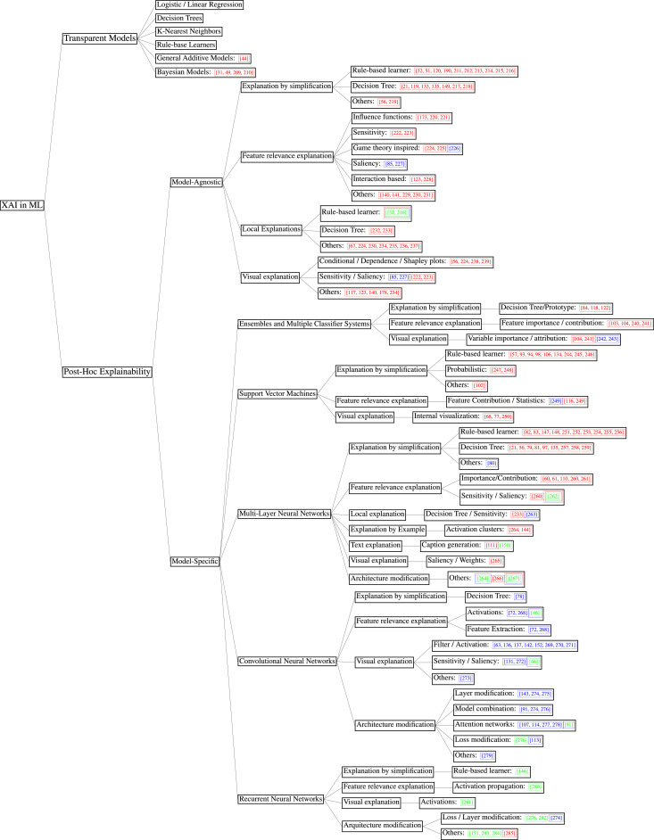
Explainable AI (XAI)
1975: a probabilistic rule-based program for medical diagnosis.
1991: an “explainable expert system” that helps Lisp coding.
1994: a “learn to explain” agent for robotics.
2002: explainable methods for Bayesian networks.
2014: explainable CNN for images classification.
2017: DARPA XAI program starts; Transformer invented.
2018: visualizing Generative Adversarial Network (GAN).
2019: explainable robot behaviors.
2020: safety and robustness of XAI studied; natural language explanations evaluation.
2022: explainable Transformer.
2023: explainable ViT; explainable LLM.
2024: explainable Large Multi-modal Model
[1] A model of inexact reasoning in medicine. Edward H Shortliffe, etc.1975.
[2] Explanations in knowledge systems: Design for explainable expert systems. William Swartout, etc. 1991
[3] Agents that Learn to Explain Themselves. W. Lewis Johnson. 1994.
[4] Visualizing and understanding convolutional networks. Zeiler, Matthew D, etc. 2014.
[5] Principles of explanatory debugging to personalize interactive machine learning. Kulesza Todd, etc. 2015.
[6] DARPA’s Explainable AI (XAI) program: A retrospective. David Gunning, etc. 2021.
[7] XAI for Transformers: Better Explanations through Conservative Propagation. Ameen Ali, etc. ICML 2022.
[8] A Concept-Based Explainability Framework for Large Multimodal Models. Jayneel Parekh, etc. NeurIPS 2024.
Image Source:
Explainable Artificial Intelligence (XAI): Concepts, Taxonomies, Opportunities and Challenges toward Responsible AI. Arrieta, etc. 2019.

Slide 9

My research on XAI
2019 ICDM: first paper to explain Probabilistic Graphical Models.
2020 CIKM: first paper on Shapley value for graph data.
2021 ICDM: first paper explaining graph topological importance.
2024 NeurIPS: robust explanations via adversarial training.
2024 NeurIPS: explaining reinforcement learning policy on graphs.
2025 ICLR: first paper explaining predictions on dynamic graphs.
2025 NeurIPS (just accepted last night!): theoretical treatment of graph explainability using Graph Geometry.
On-going: LLM explainability;
Application: AI for science (medicine, biology, geography) AI for EDA (with Huawei)
PUT XAI in action!
How XAI help human designers work faster and better with an LLM copilot.
Image Source:
https://eda.sw.siemens.com/en-US/ic/calibre-design/physical-verification/3dstack/

Slide 10
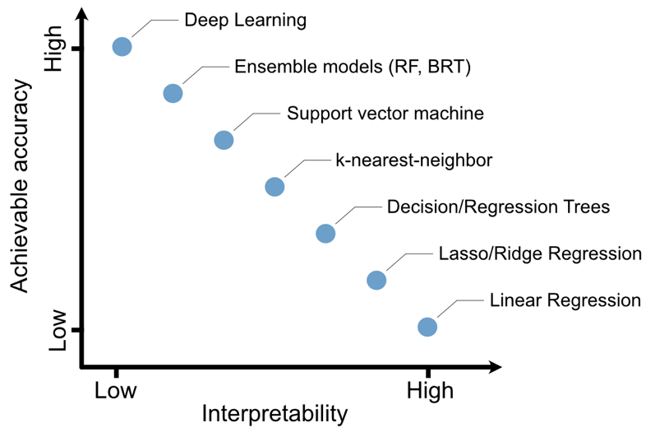
A taxonomy of traditional XAI techniques
This taxonomy was first surveyed in 2019
Global: regarding the model itself, regardless of any input.
Local: explanation model’s behavior on a specific input.
Intrinsic: white-box model interpretable without additional tool.
Post-hod: using additional tool to interpret a black-box model.
A trade-off between model accuracy and explainability
Is an explanation about the model or a prediction?
 | Global | Local
Intrinsic | Linear models sparsity, explanation-constrained, capsule networks | Linear models attention machenism
Post-hoc | LIME Data Shapley tree-based (coverage), CNN/RNN (activation maximization) | LIME Shapley values (perturbation, counterfactual, contrastive) Influence scores Gradient
Is the model itself
interpretable?
Image Source:
Machine learning and deep learning—A review for ecologists. Picher, etc. 2023.

Slide 11
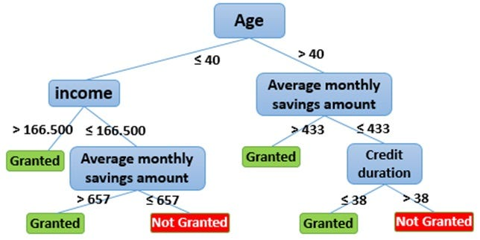
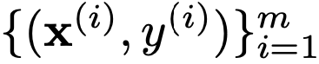
Decision trees
Build a tree for classification and regression
Start from the root, select the node with highest impure distribution
Evaluate all possible ways of splitting of the node using impurity.
Split the impurest node and maximally reduce impurity.
If Non-Stop, go to step 1; otherwise stop growing tree.
Training data
{Y, Y, N, N, N}
{Y, Y, N, N, N}
{Y, Y, N, N, N}
{Y, N}
{Y, N, N}
{Y, N}
{Y, N, N}
{Y}
{N}

Slide 12
Explaining one decision tree
One decision tree is globally and intrisically interpretable.
Extract rules by enumerating all paths from root to leaves, regardless of any input.
Extracted rules:
Age <= 40 & income > 166.5 => Granted
Age <= 40 & income <= 166.5 & AMSA > 657 => Granted
Age <= 40 & income <= 166.5 & AMSA <= 657 => Not Granted
Age > 40 & AMSA > 433 => Granted
Age > 40 & AMSA <= 433 & Credit duration <=38 => Granted
Age > 40 & AMSA <= 433 & Credit duration > 38 => Not Granted
Complexity: depth and number of the leaves
Why rules are intrinsically interpretable:
Logical structure fit human thought process
Attributes are grounded and interpretable.
Allow a case-by-case reasoning process
Allow intervention (counterfactual).
Format
Content
Image Source:
https://www.analyticsvidhya.com/blog/2021/06/what-is-predictive-analytics-an-introductory-guide-for-data-science-beginners/

Slide 13
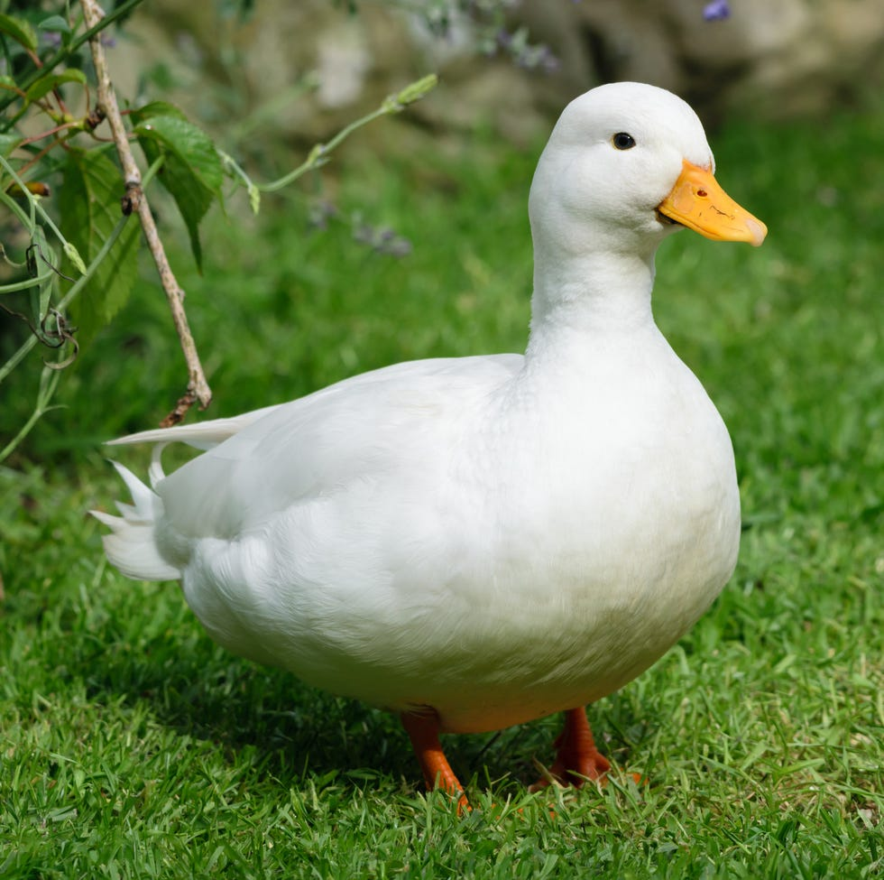


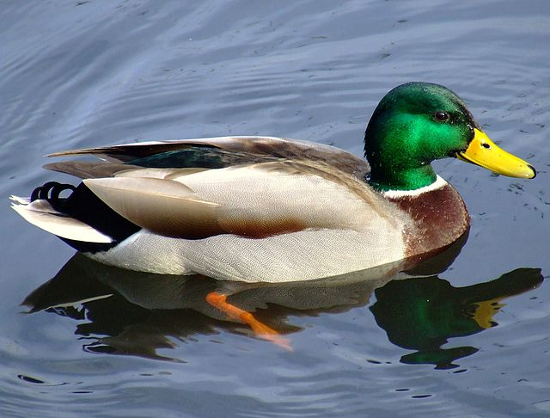
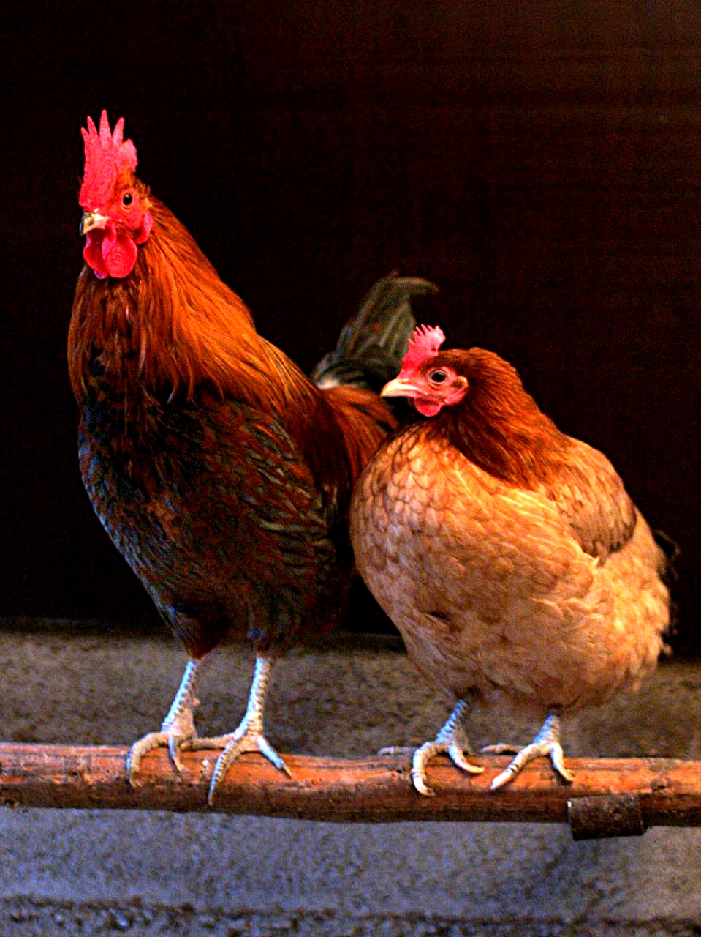
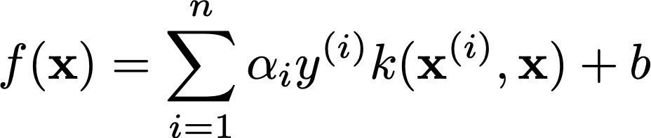
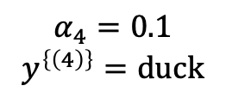
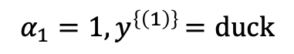
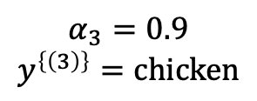
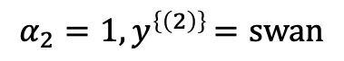
Case-based classifiers
$$α_{4}=0.1$$
$$y^{\left\{\left(4\right)\right\}}=duck$$
Use the labels of the nearest neighbors to classify the target instance:
Intuition: if an animal has feather like a duck, makes sound like a duck, walks like a duck, it’s likely a duck.
Need to choose a similarity metric
Linear or non-linear
Can combined with metric learning or representation learning.
Example classifiers: kNN, SVM
Similarity=0.8
Similarity=0.8
$$α_{2}=1{,y}^{\left\{\left(2\right)\right\}}=swan$$
Similarity=1
Examples from all possible classes
labels
Similarity=0.5
$$α_{3}=0.9$$
$$y^{\left\{\left(3\right)\right\}}=chicken$$
importance
$$α_{1}=1{,y}^{\left\{\left(1\right)\right\}}=duck$$
kernel function (similarity)
Image Source:
[1] https://en.wikipedia.org/wiki/Chicken
[2] https://www.ebay.com/itm/153813323608

Slide 14
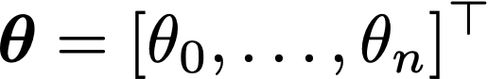

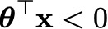
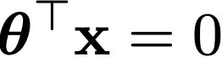
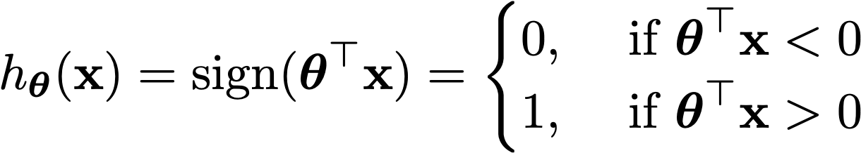
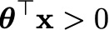
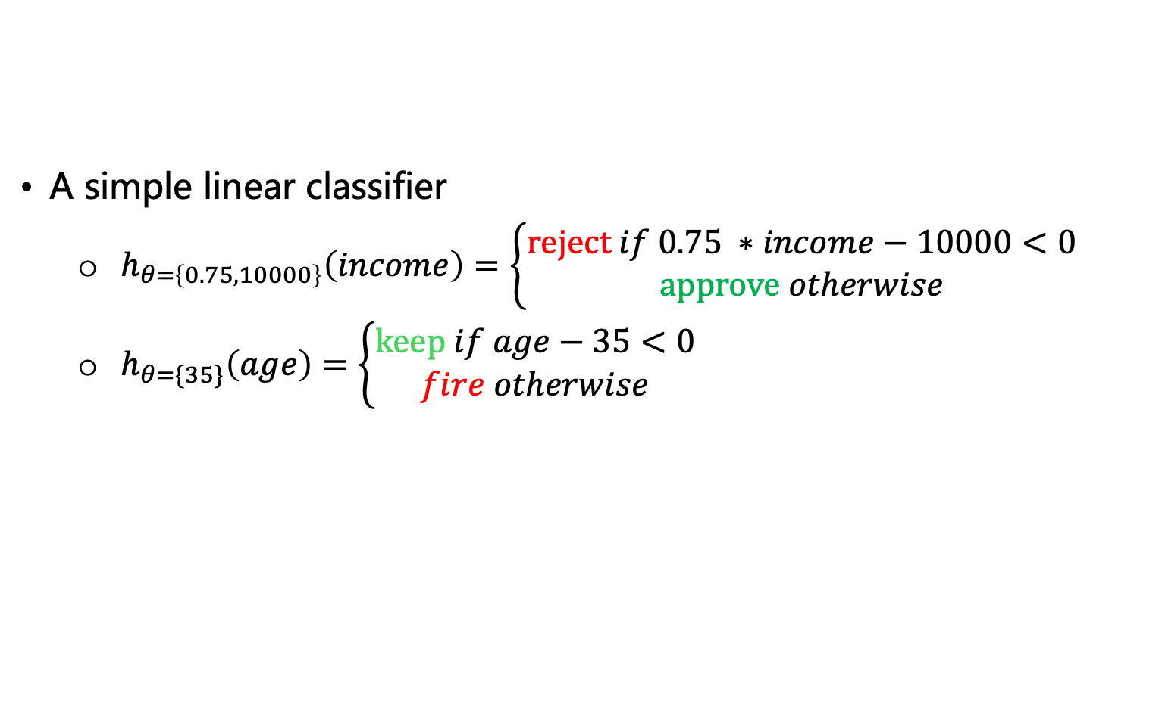
Binary linear classification
A simple linear classifier
$h_{θ=\left\{0.75,10000\right\}}\left(income\right)=\left\{\begin{aligned}reject if 0.75 ∗income−10000<0 \\ approve otherwise\end{aligned}\right.$
$h_{θ=\{35\}}\left(age\right)=\left\{\begin{aligned}keep if age−35<0 \\ fire otherwise\end{aligned}\right.$
reject
approve
income
keep
fire
age
General Linear function:
increases in the normal direction.
Classification using a linear function:
class 0
o
o
o
o
x
x
X₂
o
x
o
x
x
x
class 1
Normal direction
X₁
Notes:
\boldsymbol{\theta}^\top\mathbf{x}>0
h_{\boldsymbol{\theta}}(\mathbf{x})=\boldsymbol{\theta}^\top\mathbf{x}=\theta_0+\theta_1 x_1+\dots+\theta_n x_n

Slide 15
Explaining binary linear models
Motivation: why simple linear models are still used?
In critical domains, such as finance/medicine, linear model provide sufficient accuracy and interpretability is of high importance.
Linear model is a building-block of highly complex models include Transformers.
Global explanation: which variable is important to the model, regardless of the input data x.
Check if it aligns with domain knowledge
Annual income should be important in credit card approval.
Help users build trust on the model as a whole.
Local explanation: which input variable is important to the model at a fixed input data x.
Input x provides more contextual information, more precise to the prediction on the input x.
class 0
o
o
o
o
x
x
X₂
o
x
o
x
x
x
class 1
X₁

Slide 16
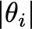
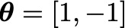
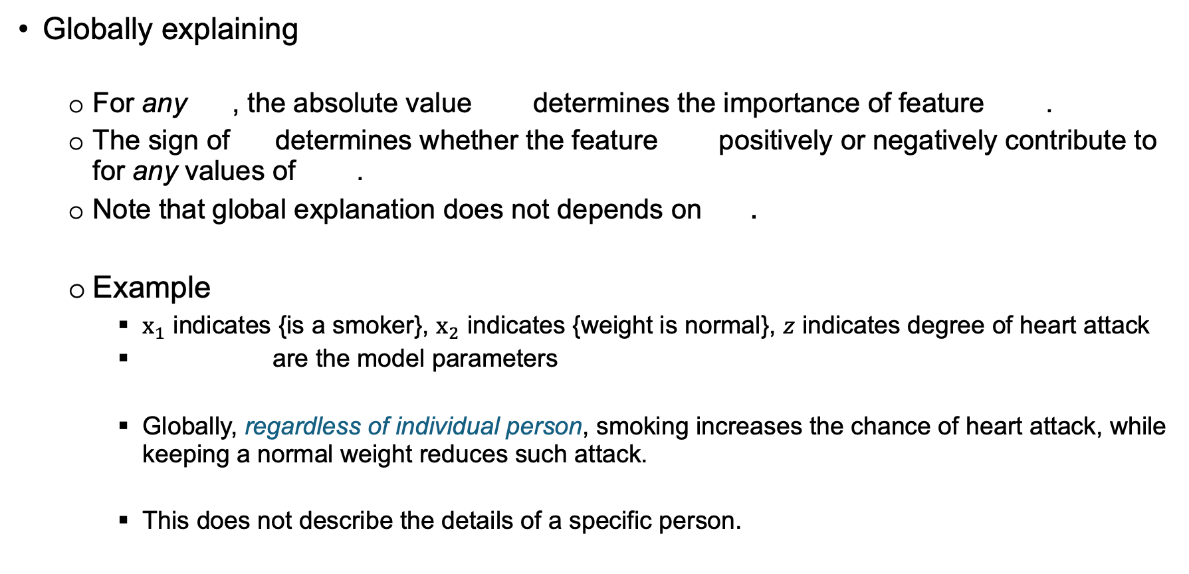
Explaining binary linear models
Globally explaining
For any , the absolute value determines the importance of feature .
The sign of determines whether the feature positively or negatively contribute to for any values of .
Note that global explanation does not depends on .
Example
$x_{1}$ indicates {is a smoker}, $x_{2}$ indicates {weight is normal}, $z$ indicates degree of heart attack
are the model parameters
Globally, regardless of individual person, smoking increases the chance of heart attack, while keeping a normal weight reduces such attack.
This does not describe the details of a specific person.
Notes:
\boldsymbol{\theta}=[1, -1]

Slide 17
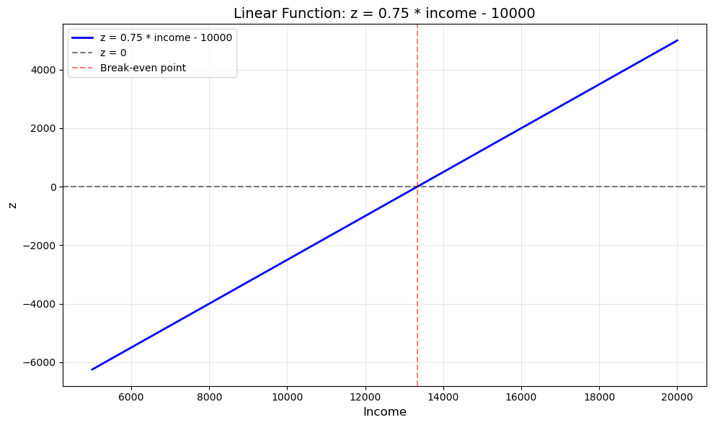
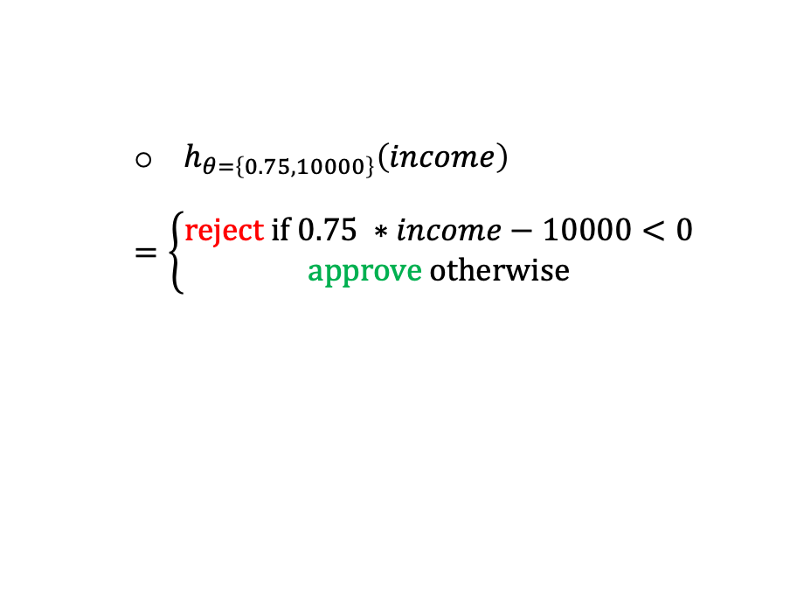
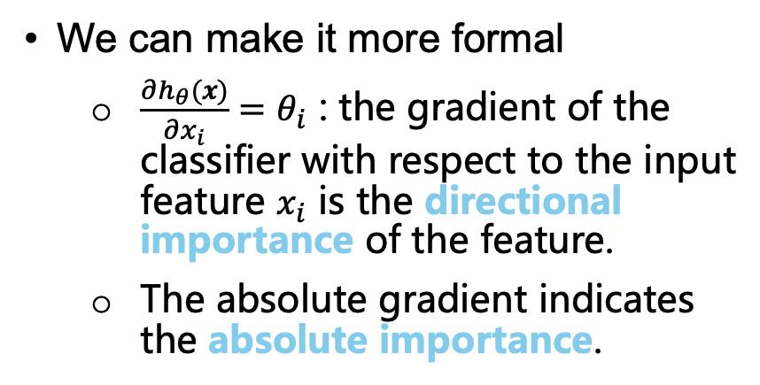
Explaining binary linear models
Another example
Global Explanation: the higher the income, the better the chance of approval: 0.75 indicates the positive relationship between the two factors.
$h_{θ=\left\{0.75,10000\right\}}\left(income\right)$
$$=\left\{\begin{aligned}reject if 0.75 ∗income−10000<0 \\ approve otherwise\end{aligned}\right.$$
We can make it more formal
$\frac{∂h_{θ}(x)}{∂x_{i}}=θ_{i}$ : the gradient of the classifier with respect to the input feature $x_{i}$ is the directional importance of the feature.
The absolute gradient indicates the absolute importance.

Slide 18
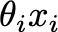
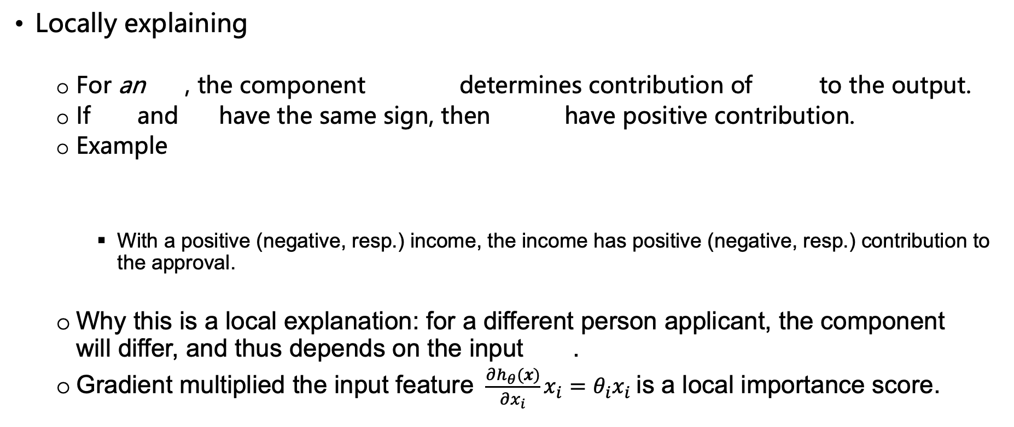
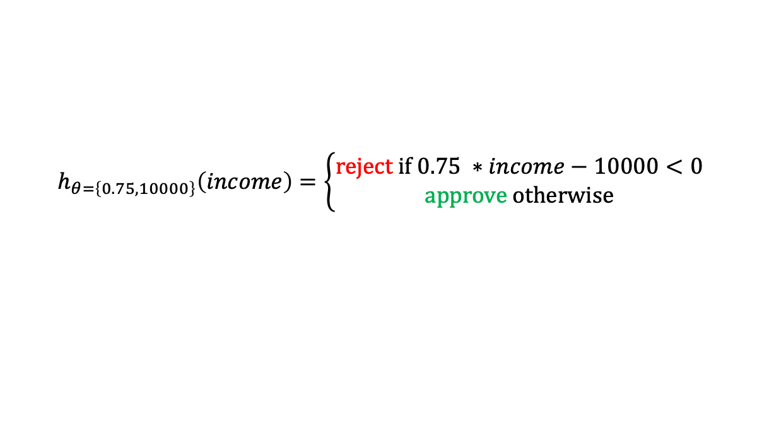
Explaining binary linear models
Locally explaining
For an , the component determines contribution of to the output.
If and have the same sign, then have positive contribution.
Example
With a positive (negative, resp.) income, the income has positive (negative, resp.) contribution to the approval.
Why this is a local explanation: for a different person applicant, the component will differ, and thus depends on the input .
Gradient multiplied the input feature $\frac{∂h_{θ}(x)}{∂x_{i}}x_{i}=θ_{i}x_{i}$is a local importance score.
$$h_{θ=\left\{0.75,10000\right\}}\left(income\right)=\left\{\begin{aligned}reject if 0.75 ∗income−10000<0 \\ approve otherwise\end{aligned}\right.$$

Slide 19
Post-hoc explanation methods
Intrinsic explainability applies to:
A single decision tree: rule extraction,
kNN and SVM: case-based,
Linear models: feature importance.
Certain models are not intrinsically explainable:
Tree ensemble, very deep models, AIGC (LLM, diffusion)
Two post-hoc methods
Model approximation
Train a simpler model using a larger model’s output
Trade accuracy for more simplicity
Counting: tree ensembles
Gradients: deep models, simple transformers.
Counterfactual thinking
Perturbation-based: Shapley, LLM,
[1] Interpretability via model extraction. Osbert Bastani, etc. 2017.

Slide 20
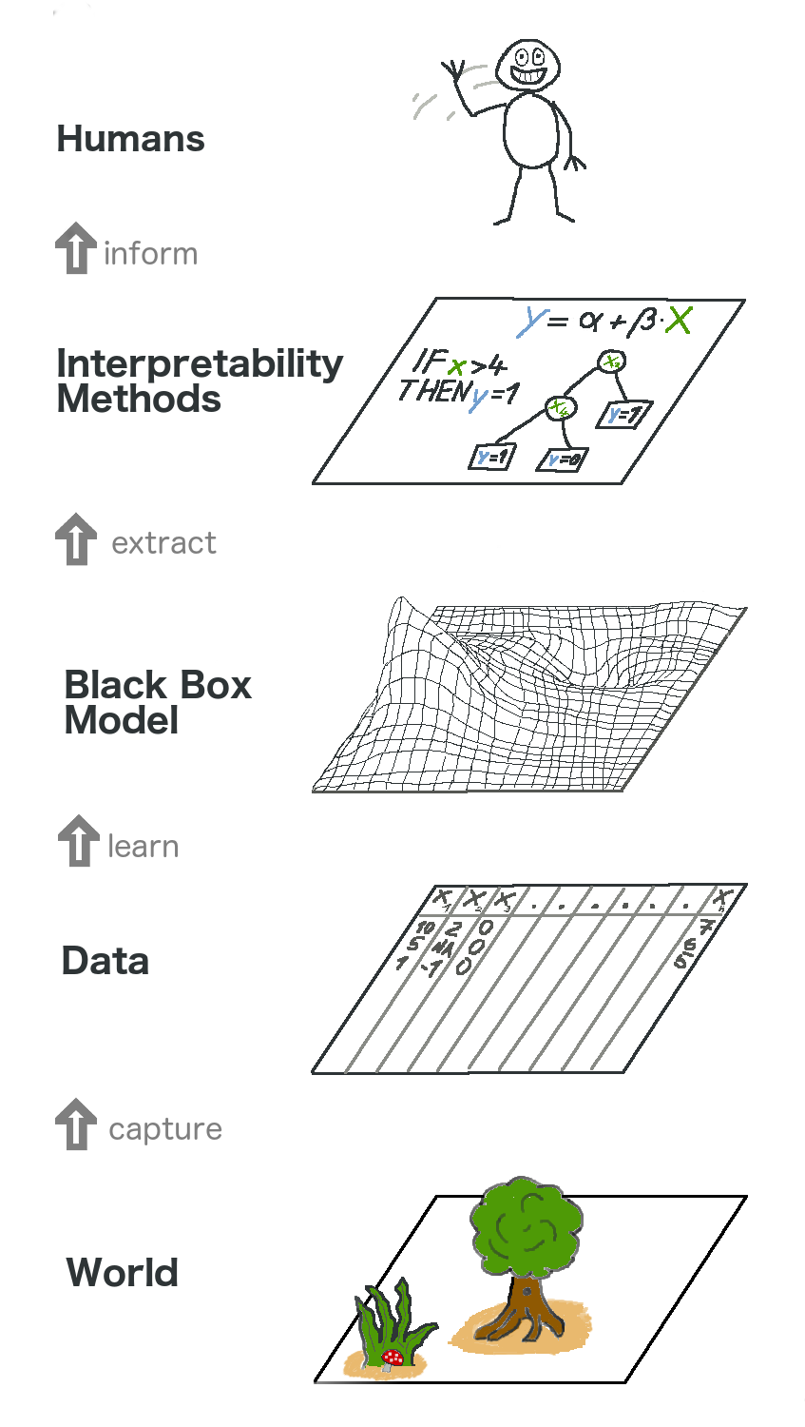
Model approximation
Target model: used to make accurate predictions in applications, but complex and less interpretable.
Two sources of complexity:
Target model prediction depends on many input features.
Features interactions (both low- and high-orders)
Example: “stock price” depends on “company size”, “earning”, “market demands”, while “size” and “earning” are correlated.
To explain is to reduce complexity via approximation:
Reveal the relationship between a feature and model output
Example: find the stock price – “company size” relationship.
Approximating model: facing human users and must be simple and interpretable.
Image Source:
https://christophm.github.io/interpretable-ml-book/overview.html

Slide 21
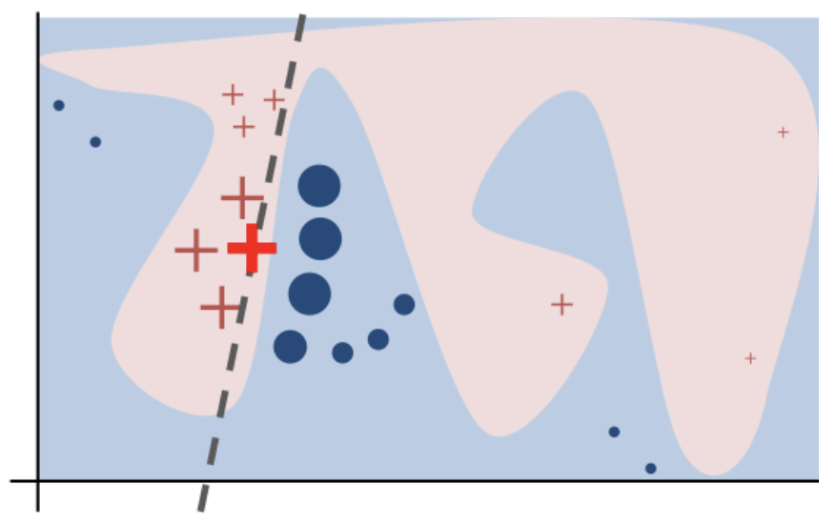

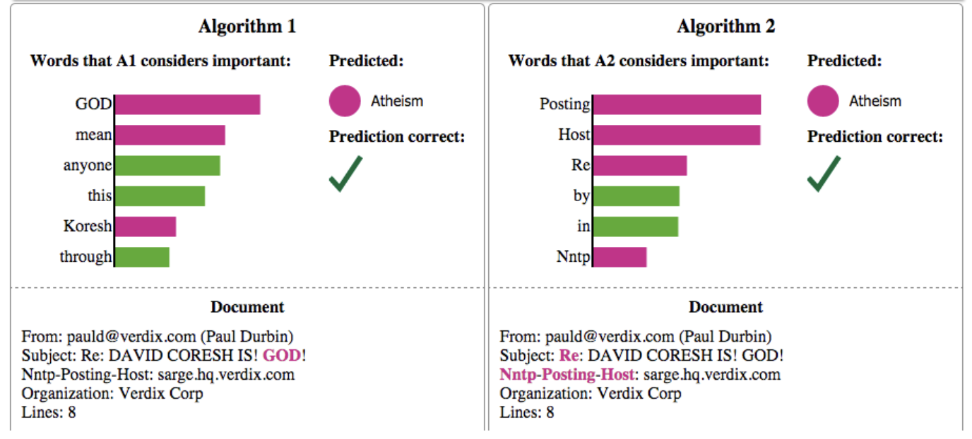
Target model:
Deep nonlinear model with
curvy decision boundary
LIME
Support local and global explanations:
Local explanation: train a sparse linear model to approximate the decision boundary of the target model at input .
Global explanation: find a subset of B training instances separable by important features, using local models’ feature weights as importance scores.
Allow any number of features in the approximation.
Model-agnostic: any target models can be explained.
Approximating model:
Linear model with low global accuracy, but accurate locally.
Local explanations for two prediction algorithms
Image Source:
IFME: Influence Function Based Model Explanation for Black Box Decision Systems. Zha, etc. 2020.
Same input:

Slide 22
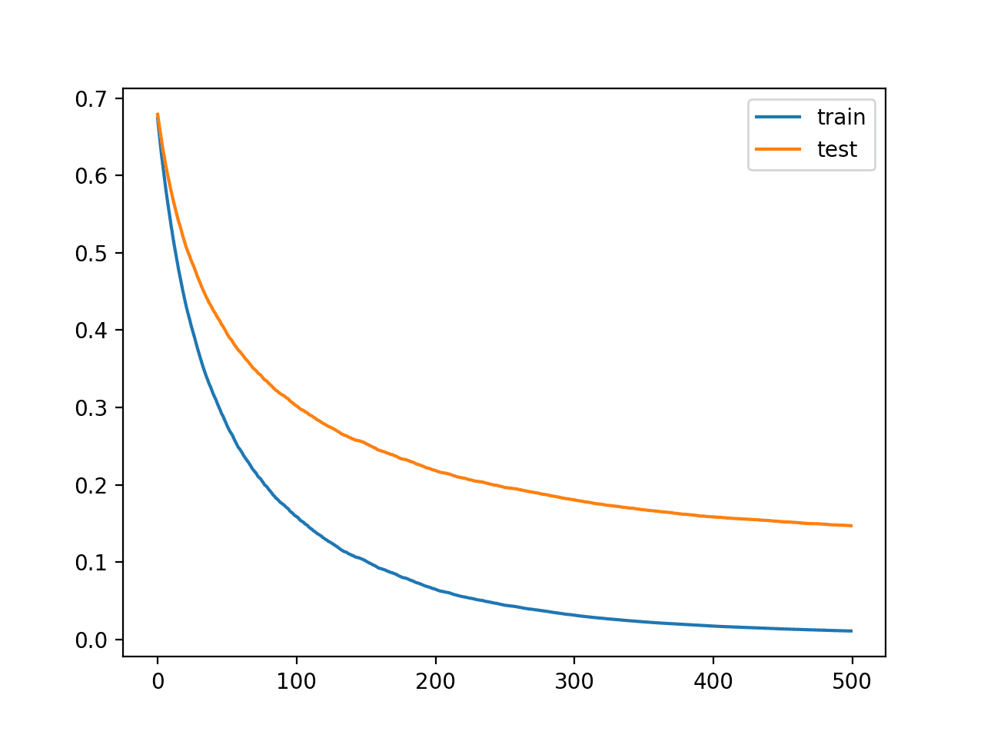
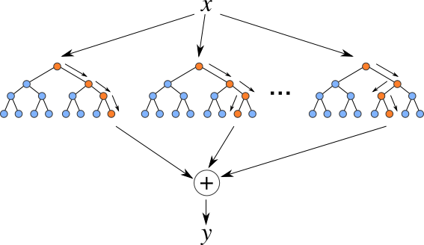
Explaining many trees
Accuracy
One tree does not offer high accuracy
Prediction = averaging many (e.g., 1000) trees’ predictions^{[1]}
One tree is intrinsically interpretable, but many trees are not
Global interpretation using feature importance
Example: the most distinguishing feature to separate high- and low-risk loan applicants is how much money in accounts.
Count of usage of a feature: how often a feature is used to partition samples.
Sum of a feature’s information gain: power for partition sample into pure classes (sort of a feature ranking method).
Number of trees
Higher accuracy
Lower interpretability
Image Source:
A hybrid time series forecasting approach integrating fuzzy clustering and machine learning for enhanced power consumption prediction. Khalaf Alsalem. 2025
[1] Random Forests. Leo Breiman. 2001.

Slide 23
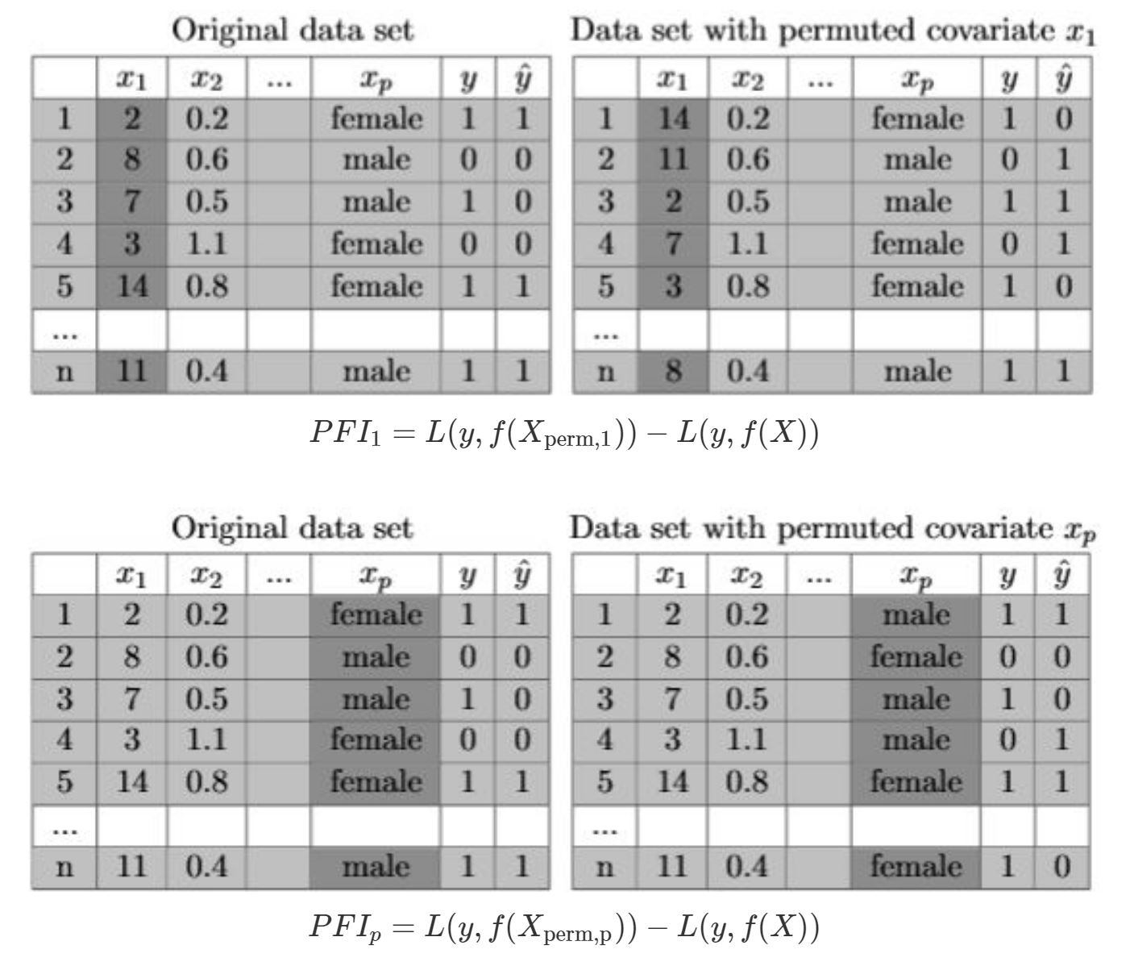
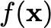


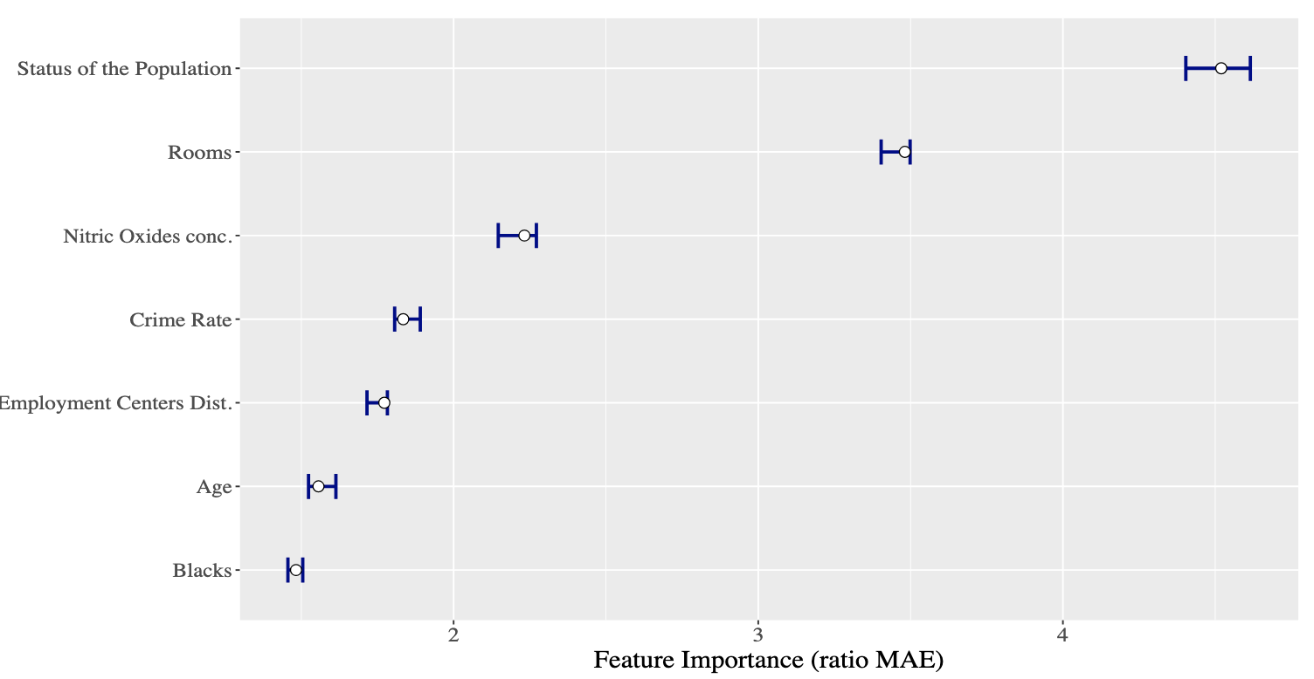
Evaluate the importance of the feature $x_{1}$
Explaining many trees
Permutation Feature Importance (PFI)^{[1]}
Given an ensemble of trees , a dataset and ground truth labels
Perturb a feature randomly on a set of data;
Make predictions on the perturbed data;
Repeat 1-2 and evaluate the average change in Mean-Absolute-Error (MAE).
The higher averge MAE, the more important the feature.
Pros:
No need of model re-training to save time
Cons:
Don’t know how to perturb the values
May lead to unrealistic cases.
For example, age = 5 and income > 50000.
Evaluate the importance of the feature $x_{p}$=‘sex’
Image Source:
https://slds-lmu.github.io/iml_methods_limitations/pfi.html
[1] Random Forests. Leo Breiman. 2001.

Slide 24
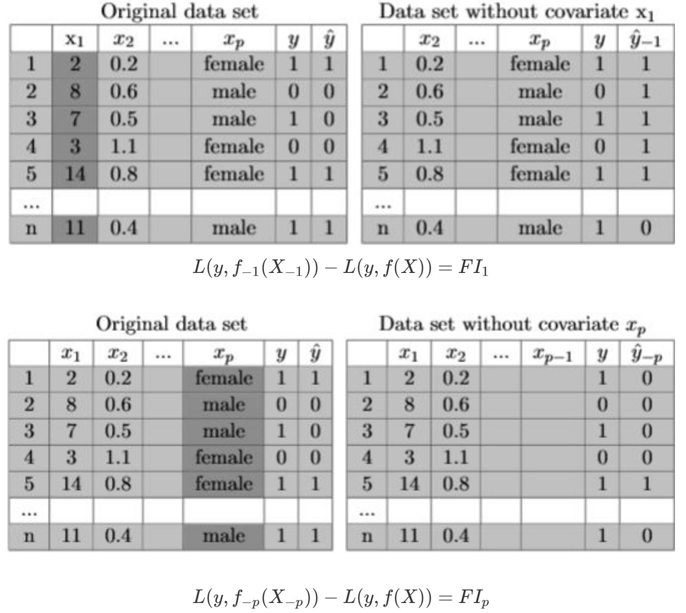
Leave-one-out score
Permutation Feature Importance (PFI)^{[1]}
Given an ensemble of trees, denoted by , a dataset and ground truth labels
Remove each feature from and re-fit the model (why?).
Evalute the change in the training error.
The higher the error change, the more important the feature.
Cons
Need time-consuming model retraining.
Not explaining the original set of trees.
Ignore feature interactions (smoke+overweight=>heart attack)
What if two features are exactly the same?
Alternatively, just set a feature to zero or its mean value to remove information about the feature to avoid model re-training.
Image Source:
https://slds-lmu.github.io/iml_methods_limitations/pfi.html
[1] Ideas on Interpreting Machine Learning. Hall, etc. 2017.

Slide 25
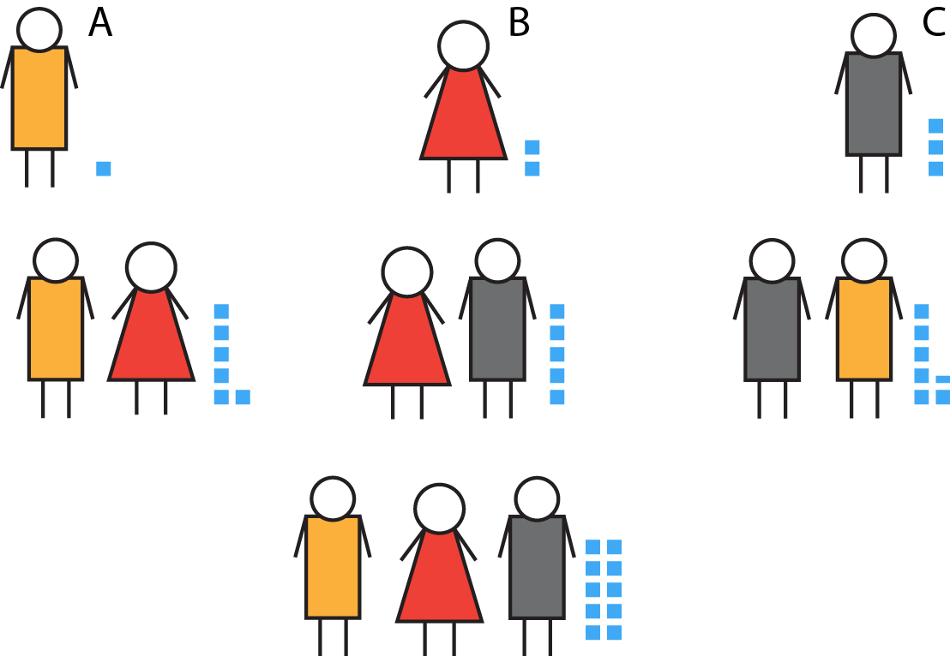
Shapley values
A game of 3 players and all possible team configuation and the outcome (indicated by the number of little blue squares). How much a player values?
It was originally invented in 1953^{[1]} to fairly (no more, no less) evaluate the importance of team members.
In a game (e.g., final project), there are 3 players (students). How to evaluate each student’s contribution?
Each student can work alone or with any others on the project. Any team configuration can generate some value.
Differentiate the cases where A presents or absents.
V({A}) – V({}) = 1-0 = 1
V({B,A}) – V({B}) = 6-2 = 4
V({C,A}) – V({C}) = 6.5-3 = 3.5
V({B,C, A}) – V({B,C}) = 10-5 = 5
The contribution of A is (1+4+3.5+5)/4
If A is important (e.g., A is the only one who can code), without him/her leads to a large difference.
If A is unimportant (e.g., replaceable), without him/her leads to a small difference.
Any one of these differences won’t fairly evaluate A’s contribution.
Image Source:
https://pjdelta.wordpress.com/2014/08/10/group-project-how-much-did-i-contribute/
[1] A value for n-person games. L. S. Shapley. 1953.

Slide 26

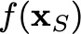
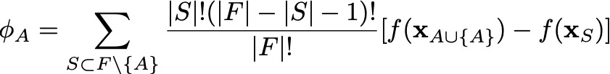
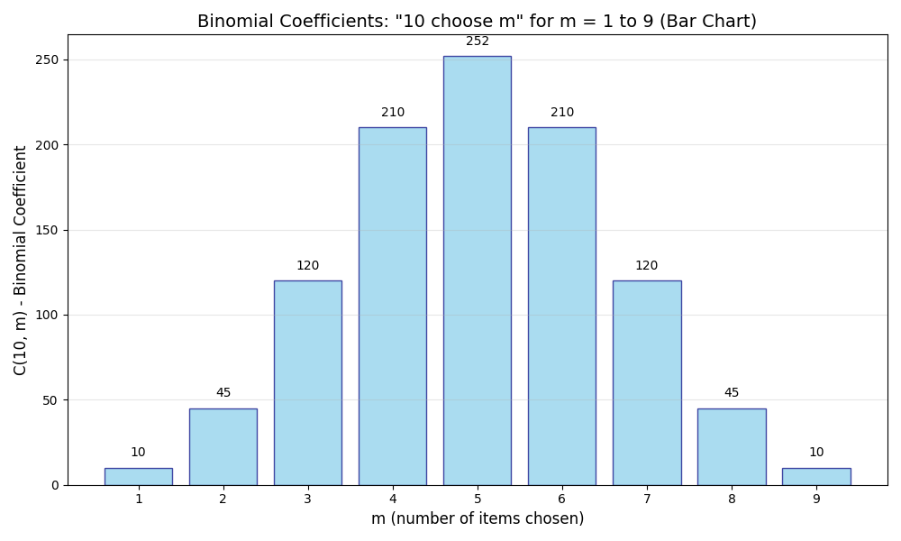
Shapley values for feature importance
Given any feature subset , Model is trained on feature subset and makes predict using the feature subset .
Shapley value of feature A (a player) is defined as
S
A
F
Normalizing by how likely a specific configuration will happen: the more frequent, downweight the difference.
[1] An efficient explanation of individual classifications using game theory. I KononenkoI, etc. Journal of Machine Learning Research. 2010.
[2] A linear approximation method for the shapley value. S.S Fatima, etc. Artificial Intelligence. 2008.
Notes:
f(\bx_{S})
\phi_A=\sum_{S\subset F\setminus \{A\}} \frac{|S|! (|F|-|S|-1)!}{|F|!}[f(\mathbf{x}_{S\cup \{A\}})-f(\mathbf{x}_{S})]
\phi_A=\frac{1}{n!}\sum_{\pi\in\Pi}[f(\mathbf{x}_{S_A(\pi)\cup\{A\}})-f (\mathbf{x}_{S_A(\pi)})]

Slide 27
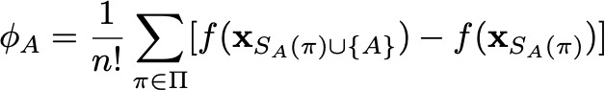
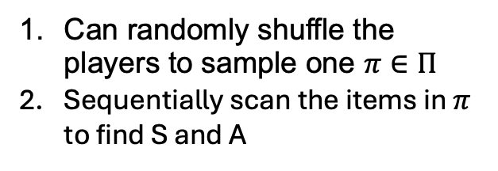


Shapley values for feature importance
It is usually infeasible to find the exact Shapley values and sampling is needed.
It can also be calculated as
All features upto A (inclusive)
in the permutation π
All features upto A (exclusive)
in the permutation π
Can randomly shuffle the players to sample one $π∈Π$
Sequentially scan the items in $π$ to find S and A
All permutations $Π$
$$π$$
S
A
Try all prefix S
[1] An efficient explanation of individual classifications using game theory. I KononenkoI, etc. Journal of Machine Learning Research. 2010.
[2] A linear approximation method for the shapley value. S.S Fatima, etc. Artificial Intelligence. 2008.
Notes:
f(\bx_{S})
\phi_A=\sum_{S\subset F\setminus \{A\}} \frac{|S|! (|F|-|S|-1)!}{|F|!}[f(\mathbf{x}_{S\cup \{A\}})-f(\mathbf{x}_{S})]
\phi_A=\frac{1}{n!}\sum_{\pi\in\Pi}[f(\mathbf{x}_{S_A(\pi)\cup\{A\}})-f (\mathbf{x}_{S_A(\pi)})]

Slide 28
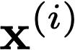
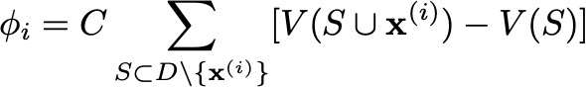

Data Shapley
The same idea can be used to evaluate data point importance, thus generating case-based explanations.
A data point can contribute to the final model test accuracy along with any data subset and its overall contribution is
It can also be calculated by enumerating all permutations of the data points:
The above re-formulation allows an online Monte-Carlo algorithm:
Randomly shuffle the whole dataset and then scan it sequentially,
For the next data point , update the model parameter using information in ,
Then evalute the change in test accuracy.
V is a contribution function, such as model accuracy, to measure reduction in accuracy due to missing a data point.
[1] Data Shapley: Equitable Valuation of Data for Machine Learning. Amirata Ghorbani, etc. ICML 2019.
Notes:
\phi_i=C\sum_{S\subset D\setminus \{\mathbf{x}^{(i)}\}} [V(S\cup \mathbf{x}^{(i)})-V(S)]

Slide 29

Counterfactual explanation
A counterfactual explanation describes a causal situation.
It is a way of thinking, and can be local or global explainability.
Example:
If X had not occurred, Y would not have occurred

Slide 30
Counterfactual explanation
Counterfactual explanation: find a counterfactual example whose predicted class flips to another class
Example: Peter applies for a loan and gets rejected by AI. He change his spending behaviors to improve his chances.
Ask for minimal changes to the original input to be relevant
A very different case will naturally be predicted to a different class, thus not probing the model’s local behavior near the original input.
In practice, minimal change give users actionable suggestions: increase your annual income by 10000 RMB, rather than 1000000 RMB.
Multiple diverse counterfactual explanations (Rashomon effect)
Example: change spending, address, saving amount, income, etc.
Reasonable values: change size from 100 to 10 m² while keeping 3 bedrooms.

Slide 31

Counterfactual explanation: visualization
GIF Source: https://medium.com/@bijil.subhash/explainable-ai-diverse-counterfactual-explanations-dice-315f058c0364

Slide 32





Counterfactual explanation: optimization
Method by Wachter et al. ^{[1]}
Minimize
Algorithm:
Initialize a counterfactual example $x′$ and some $λ$
Optimize $x′$ by minimizing L
While not satisfied , increase $λ$ (so to focus more on reducing the first term)
Does not consider reasonable data values and number of changed features
Method by Dandl et al. ^{[2]}
Minimizing multiple objectives
Change as less number of features as possible,
so that the change is feasible.
Close to the most similar observed data,
making counterfactual realistic.
[1] Counterfactual explanations without opening the black box: Automated decisions and the GDPR. Wachter Sandra, etc. 2017.
[2] Multi-objective counterfactual explanations. Dandl Susanne, etc. 2020.
Notes:
|\hat{f}(x’)-y’|>\epsilon

Slide 33




Counterfactual explanation: example
Approval
probability 24.2 %
Input $x$
Approval
probability
Diverse multiple
Counterfactuals $x′$
Not realistic changes
Too many changes

Slide 34

Explanation evaluation metrics
Taxonomy of evaluation approaches for interpretability^{[1]}
Examples:
Doctors + deployed AI in a hospital with a patient
Doctors judge explanations in office without patients.
Machines calculate metrics for explanations.
A research paper usually have a mixture of the last two approaches, while the application-grounded evaluation is too costly to perform on a regular basis.
Image Source:
Towards A Rigorous Science of Interpretable Machine Learning. Finale Doshi-Velez, etc. 2017.

Slide 35

Real human evaluation on simple tasks
Evaluating decision sets [1] and lists [2], which can be learned
Human evaluation of global rules: ask humans to write a description of the classifier based on the rules, then experts evaluate the description to get an correct/incorrect answer. Shorter time, shorter descriptions, and higher accuracy are better.
Human evaluation of local rules: ask humans to use the rules to decide if a simulated patient has a disease given some feature values. Shorter time and higher accuracy are better.
Conclusions: decision sets lead to better human evaluation performance.
[1] Interpretable Decision Sets: A Joint Framework for Description and Prediction. Himabindu Lakkaraju, etc. KDD 2016.
[2] Learning Decision Lists. RL Rivest. 1987.

Slide 36

Quantitative evaluation
Human-grounded evaluation cannot be reproduced and cannot be scaled.
Need functionally-grounded evaluation, using quantitative metrics:
Faithfulness: how close the explanation can approximate the predictions of the target model.
Complexity: how many explaining elements are used and how they are fit together.
[1] Towards A Rigorous Science of Interpretable Machine Learning. F Doshi-Velez, etc. 2017
[2] “Why Should I Trust You?”: Explaining the Predictions of Any Classifier. Marco Tulio Ribeiro, etc. KDD 2016.
Image Source:
[3] IFME: Influence Function Based Model Explanation for Black Box Decision Systems. Zha, etc. 2020.

Slide 37


Quantitative evaluation
Need functionally-grounded evaluation, using quantitative metrics:
Counterfactual: change the identified elements in the explanation to change the model output. Help establish a causal-outcome relationship.
Sanity check^{[1]}: is an explanation invariant to irrelevant input perturbations?
Later used by many LLM explanation evaluation
Image Source:
[1] The (Un)reliability of Saliency Methods. PJ Kindermans. 2017.
[2] Analysis of Explainers of Black Box Deep Neural Networks for Computer Vision: A Survey. David Muench, etc. 2021.

Slide 38


Looking forward
Methods for Deep Neural Networks and reinforcement learning.There are many interesting methods to discussed.
Relationship between all these methods [1].
Interactions with other responsibility areas (privacy, fairness, robustness)
Interpreting Transformer and large foundation models.
Surveys:
Techniques for Interpretable Machine Learning. CACM. 2020
A Multidisciplinary Survey and Framework for Design and Evaluation of Explainable AI Systems. ACM TIST 2020
Methods for interpreting and understanding deep neural networks. 2017
Towards A Rigorous Science of Interpretable Machine Learning. 2017
[1] A unified approach to interpreting model predictions. S. M. Lundberg, etc. 2017.
Image Source:
[2] Ten years after ImageNet: a 360° perspective on artificial intelligence. Sanjay Chawla, etc. 2023.
[3] https://www.smithsonianmag.com/innovation/artificial-intelligence-is-now-used-predict-crime-is-it-biased-180968337/

